Slide 1
Using text mining of amazon reviews to explore user-defined product highlights and issues
Project 3
Xun Zha, Ao Pan, Henan Wang, Peiwei Li, Yanran Liu

Slide 2
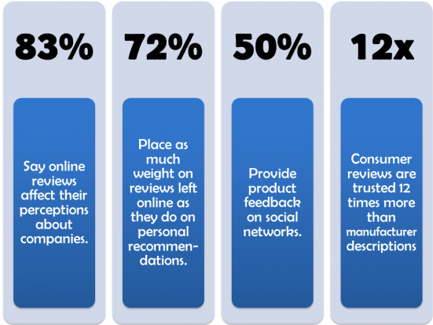
Research background
Notes:
Customer reviews are becoming increasingly available in the E-commerce website like Amazon.com for a wide range of products and services (Mudambi & Schuff, 2010).
90% of customers read online reviews before making a purchase decision, and they are now essential for e-commerce sites.
85% of consumers trust online reviews as much as personal recommendations
Positive reviews make 73% of consumers trust a local business more
49% of consumers need at least a four-star rating before they choose to use a business

Slide 3


What is the problem?
From customer perspective:
It is impossible to read all of the reviews
Difficult to understand a product comprehensively
Difficult to realize the critical features of product
From manufacturer perspective:
Difficult to response to every customer reviews
In this research, the problem is how to use Text Mining techniques as tool to quickly understand the highlights and issues of a product.
Notes:
As the number of product reviews grows rapidly, a popular product can obtain thousands of reviews in a short period. It is difficult for customers to read all of these reviews comprehensively before make purchases. Also, the huge amount of reviews makes the product tracking more difficult for manufacturers (Hu & Liu, 2004).
what basic features are most important to users of the product and most influential in molding their perceptions?

Slide 4



Why is this problem important?
Feed backs from users could be analyzed:
Consumers can quickly know the pros and cons of a product
Understand what contributes to a product’s overall rating
Consumers can benefit from other consumers’ comments
Enhance the product features:
Be responsible to consumers’ feedbacks
Identify what consumers are concerned about
Resolve uncovered issues
Notes:
As the number of product reviews grows rapidly, a popular product can obtain thousands of reviews in a short period. It is difficult for customers to read all of these reviews comprehensively before make purchases. Also, the huge amount of reviews makes the product tracking more difficult for manufacturers (Hu & Liu, 2004).
what basic features are most important to users of the product and most influential in molding their perceptions?

Slide 5




Is there any related work?
Social media
Several topic modeling techniques based on LDA
Huge amount of data
Data mining is more difficult
Information platforms
Trending topics, popular news, breaking news
Easy to gather information via smartphones
Determine location
Notes:
As the number of product reviews grows rapidly, a popular product can obtain thousands of reviews in a short period. It is difficult for customers to read all of these reviews comprehensively before make purchases. Also, the huge amount of reviews makes the product tracking more difficult for manufacturers (Hu & Liu, 2004).
what basic features are most important to users of the product and most influential in molding their perceptions?

Slide 6
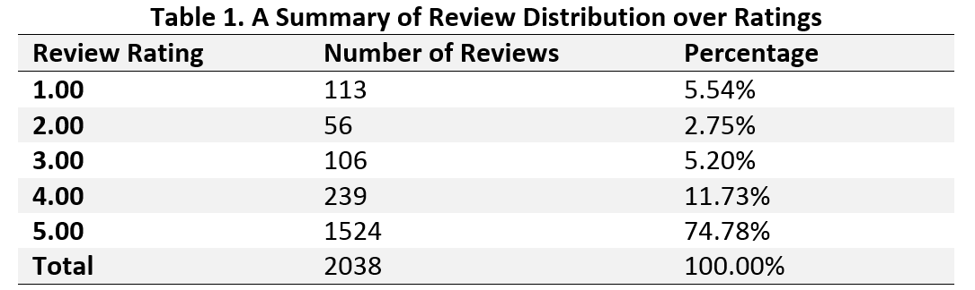
Data Description
2038 Amazon reviews for 88 products
Five-star reviews dominate other reviews for each of the products

Slide 7
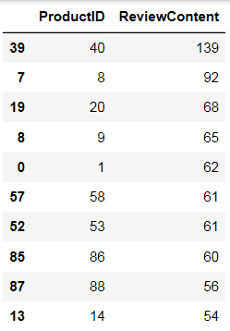
Data Extraction
Ranked products by their numbers of reviews
Selected top ten products with most reviews

Slide 8
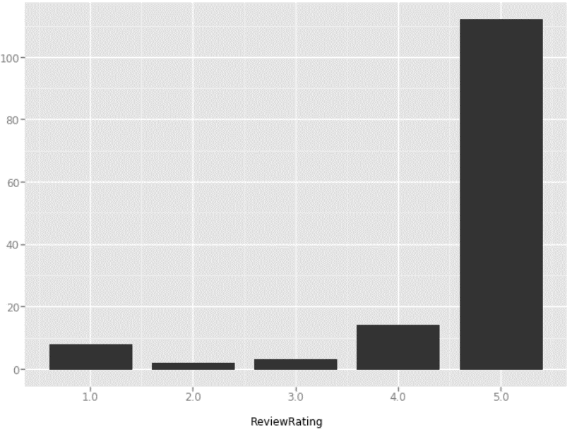

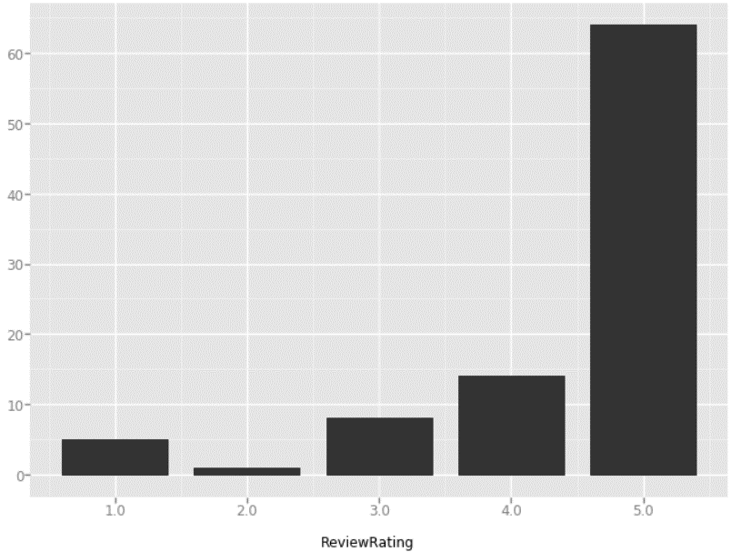
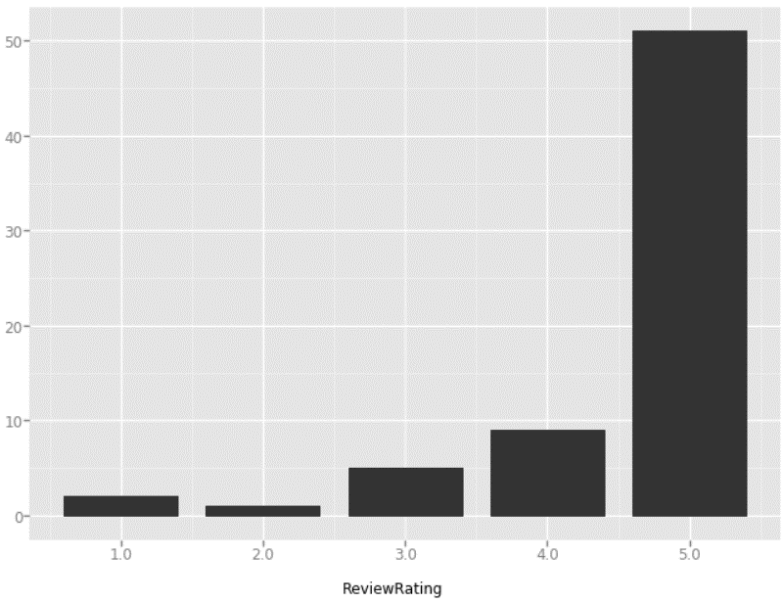
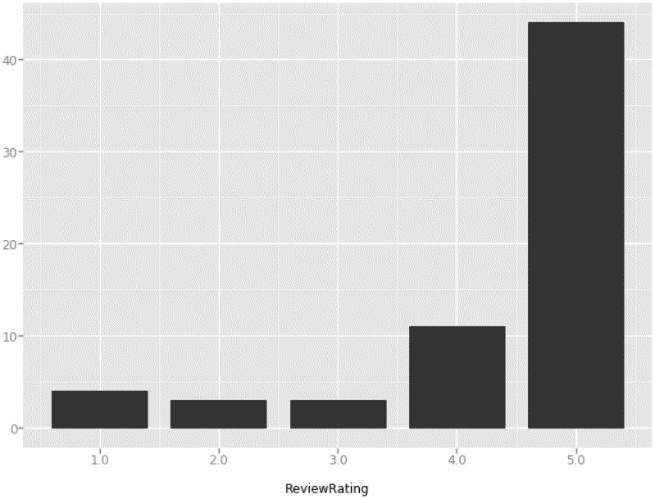



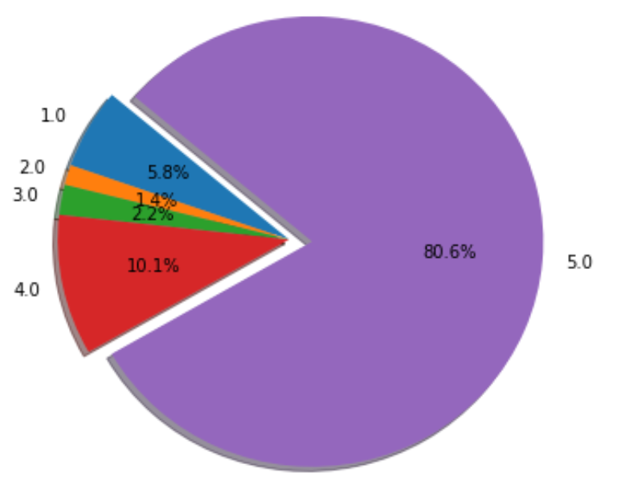
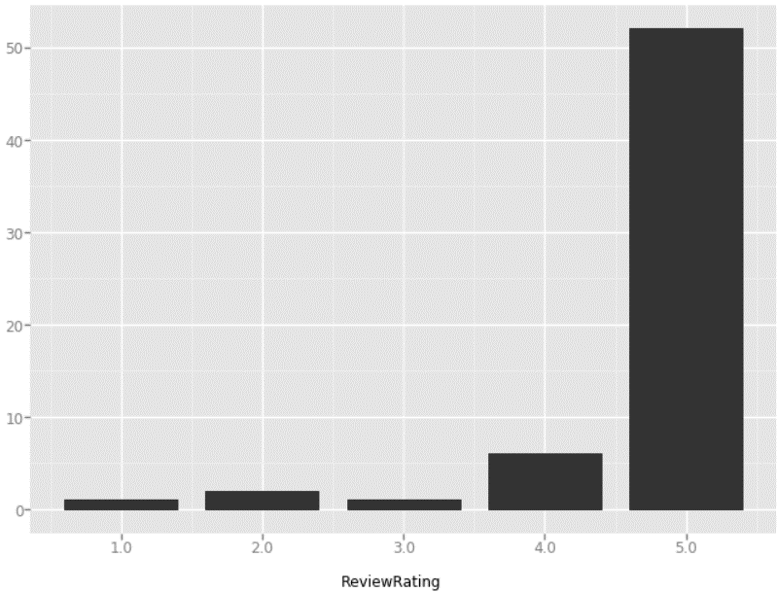
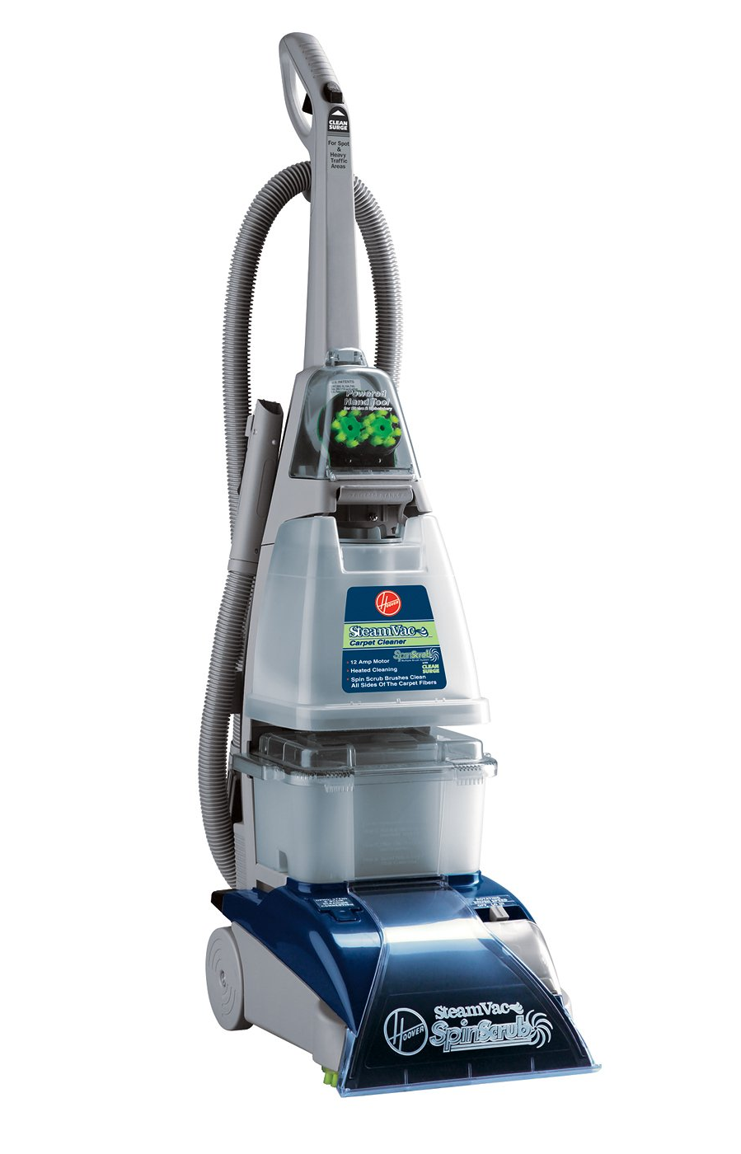
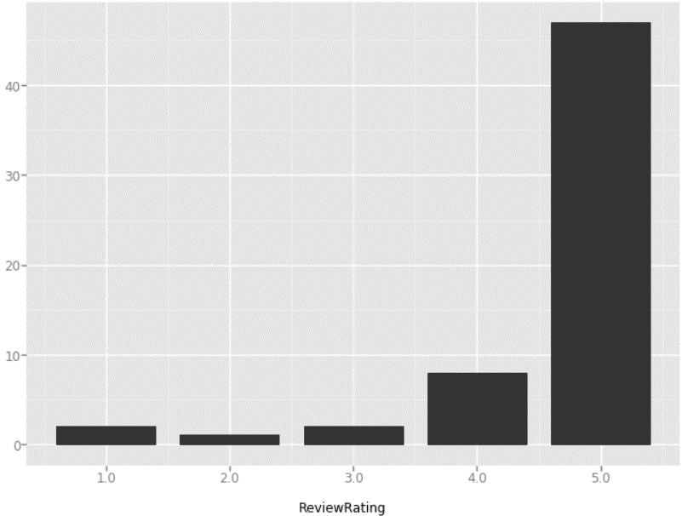

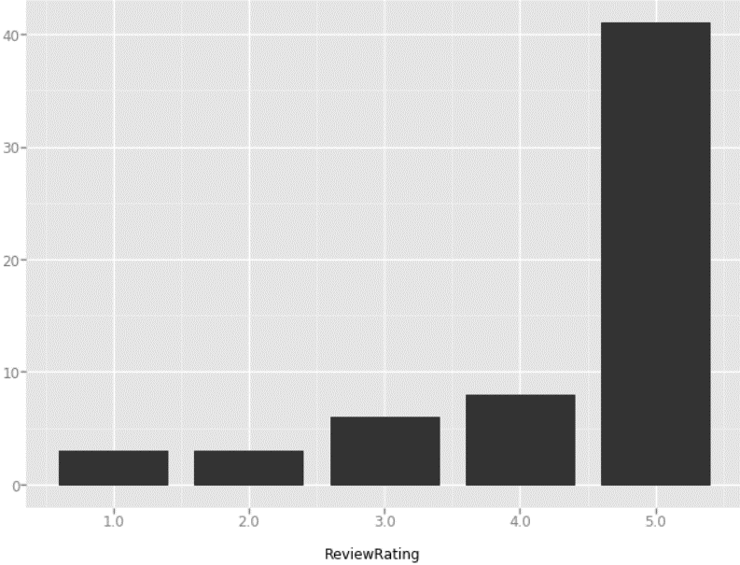
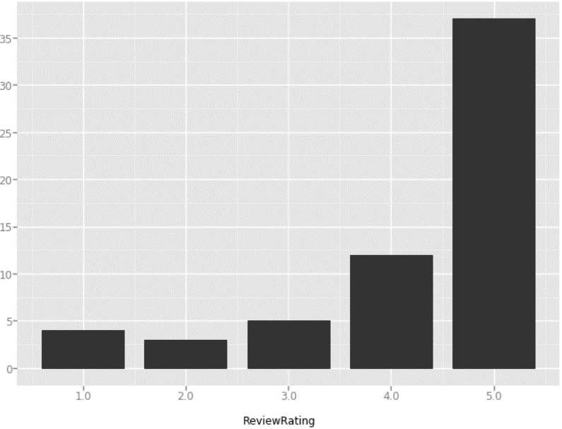


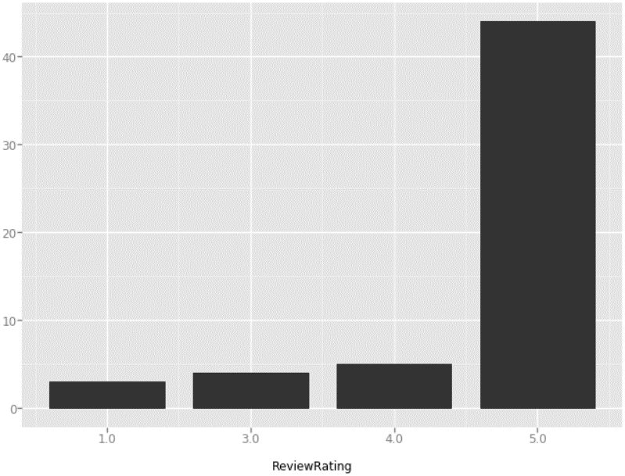
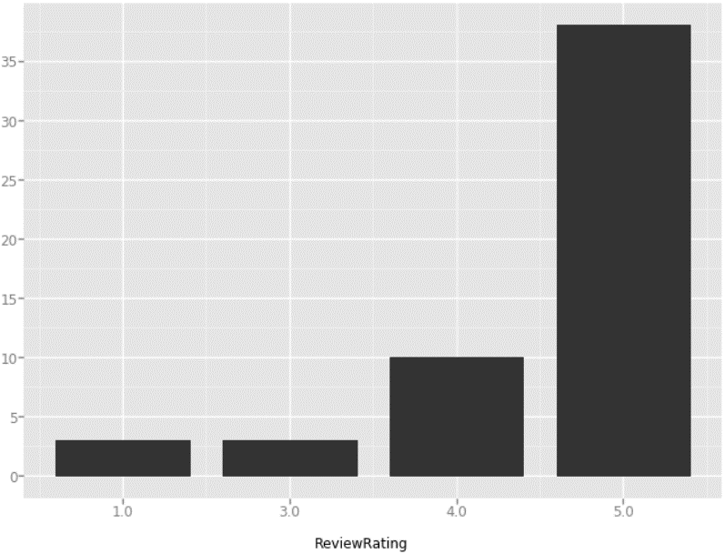


Review Distribution over Ratings
P 40
P 8
P 20
P 9
BAD REVIEW DATA
P 1
P 58
P 53
P 86
GOOD REVIEW DATA
P 88
P 14
Percentage of Reviews for Each Rating of Product 40
Notes:
P 40 – Toner
P 8 – Grinder
P 20 – Air popper
P 9 – Brita pitcher
P 1 – Resistance band set
P 58 – Handheld spiralizer
P 53 – Vac carpet cleanser
P 86 – Battery maintenance charger
P 88 – Percolator coffee pot
P 14 – Pyrex glass containers

Slide 9
Data Cleaning
Made words lowercase and stripped away the punctuations
Kept only adjectives, nouns, adverbs, interjections and verbs
Tokenized and lemmatized the texts
Computed bigrams
E.g., “machine learning” → “machine_learning”
Removed the stop words
Notes:
3. -- We did not stem because lemmatizing could keep the integrity of words and make words easy to be understood, smoothing our interpretation of topic-modeling results.
4. --

Slide 10
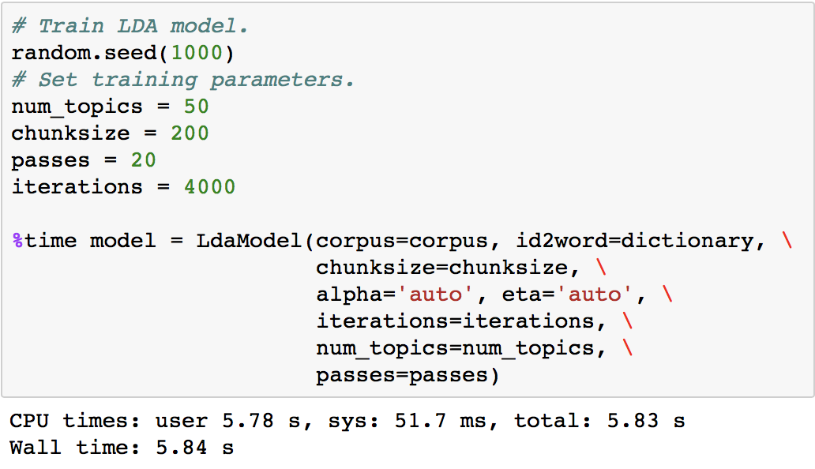
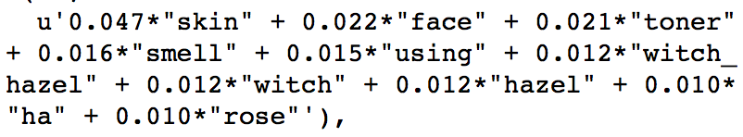
Model Training
LDA model for topic modeling to discover the highlight and issues
Retrieve the most related topic for each product
Examine the top 10 words for each topic of the products
Topics for Product 40( Toner)
Improvement !

Slide 11
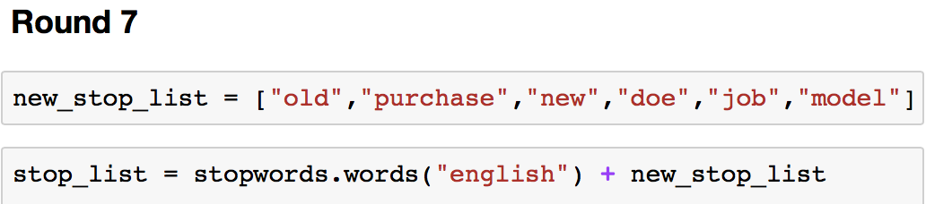
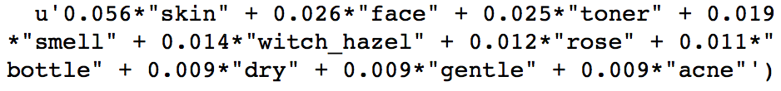
Model Improvement
Appending meaningless words to our Stopword list
Retrain the model with new corpus
Review the results and repeat the process
Redo the all steps for bad reviews to find the issues of each product
After 7 rounds improvement,
the highlight of the product
came out.

Slide 12
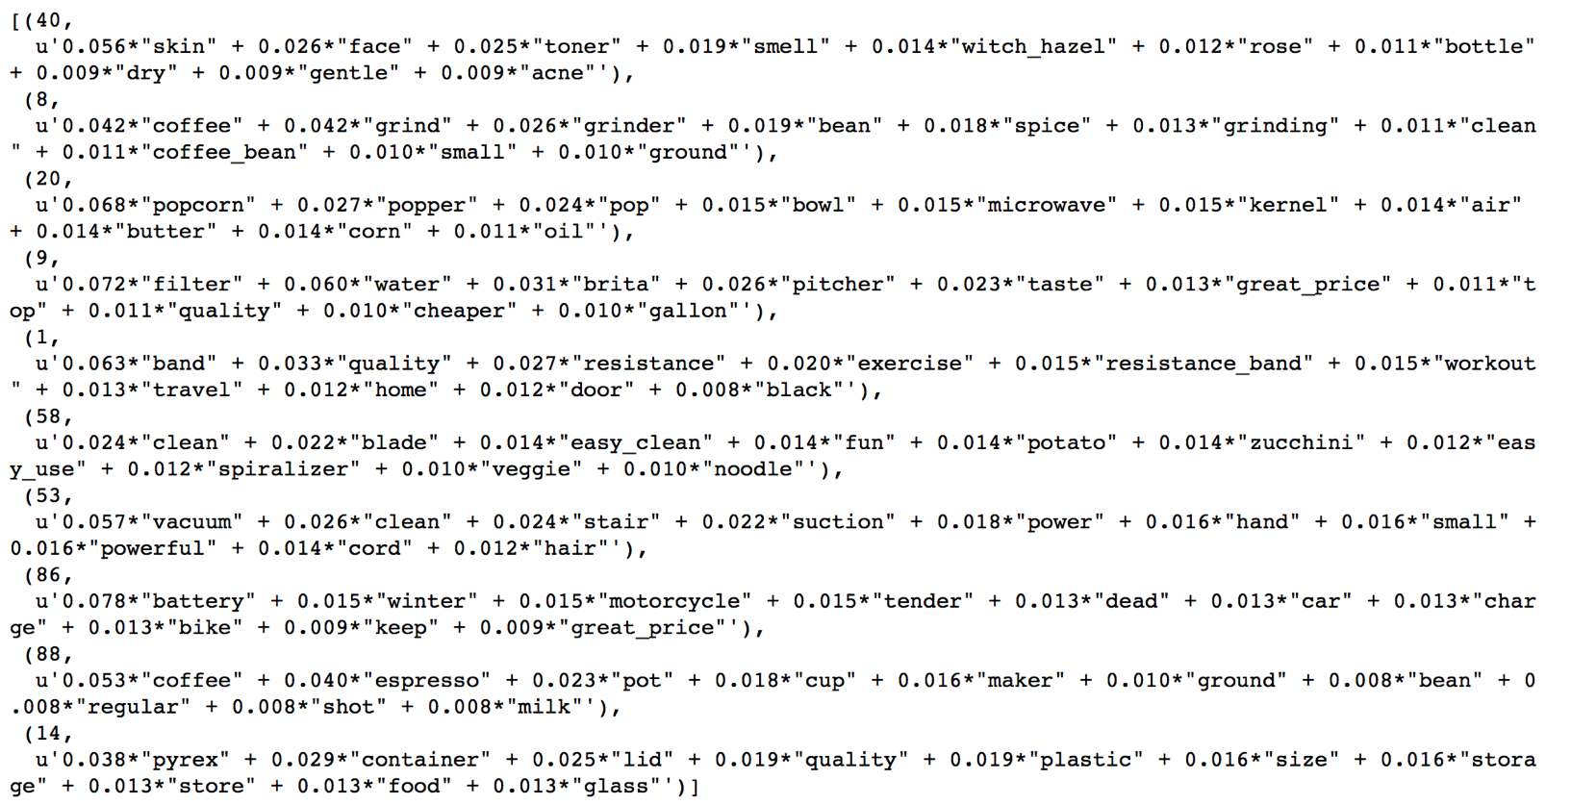
Good Result Interpretation
Product ID | Product Name | Pros
40 | Toner | Good Smell, Good for Acne
53 | Vacuum | Powerful, Easy Clean
9 | Brita Pitcher | High Quality, Cheap, Tasty Water

Slide 13
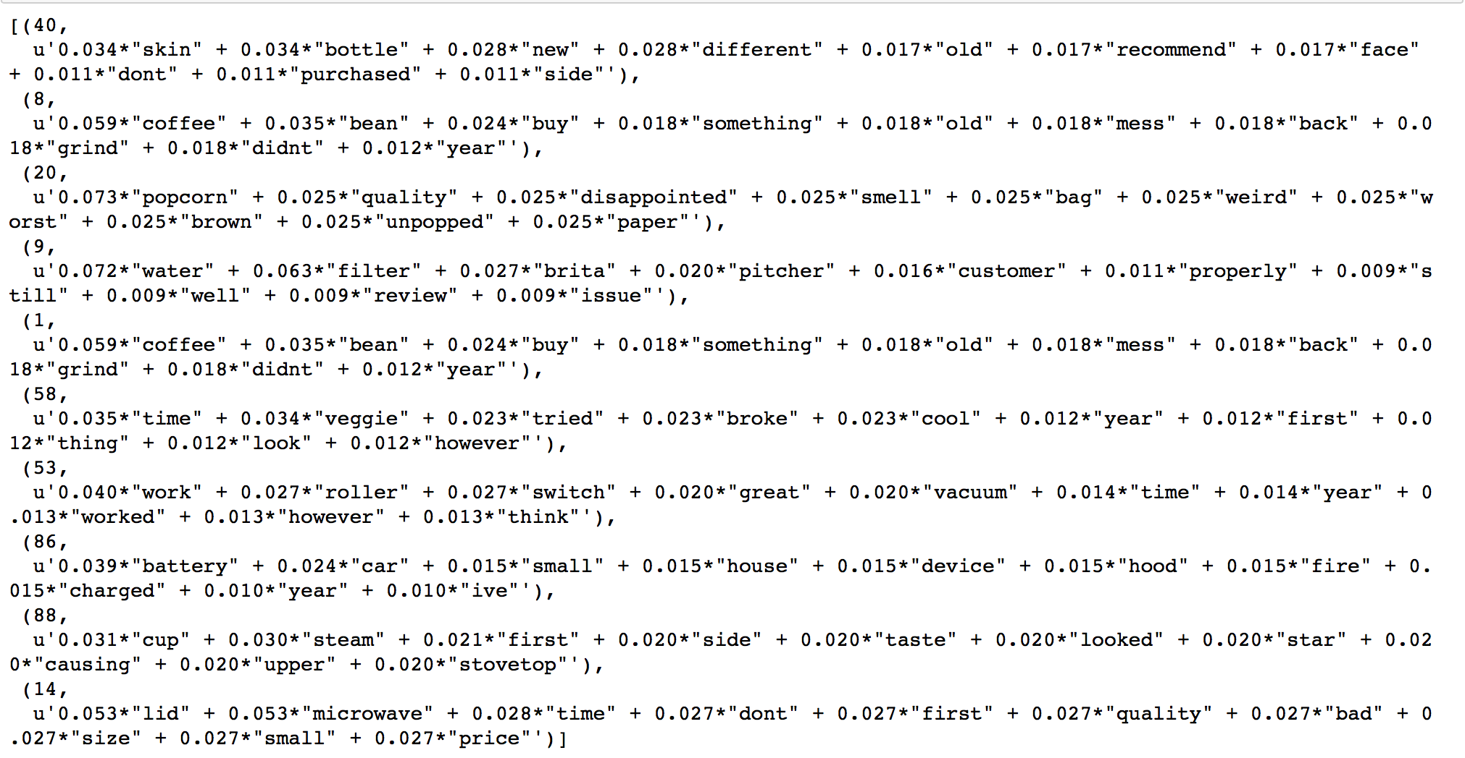
Bad Result Interpretation
Product ID | Product Name | Cons
20 | Popcorn Popper | Unpopped, Disappointed Quality
14 | Pyrex Container | Poor Lids Quality

Slide 14
Thank you

